Slide 1
Mining of social media data to Inform COVID-19 Response in Uganda
Atwine Mugume. T
Email: twinmugume@gmail.com, Twitter: @AtwineMugume

Slide 2
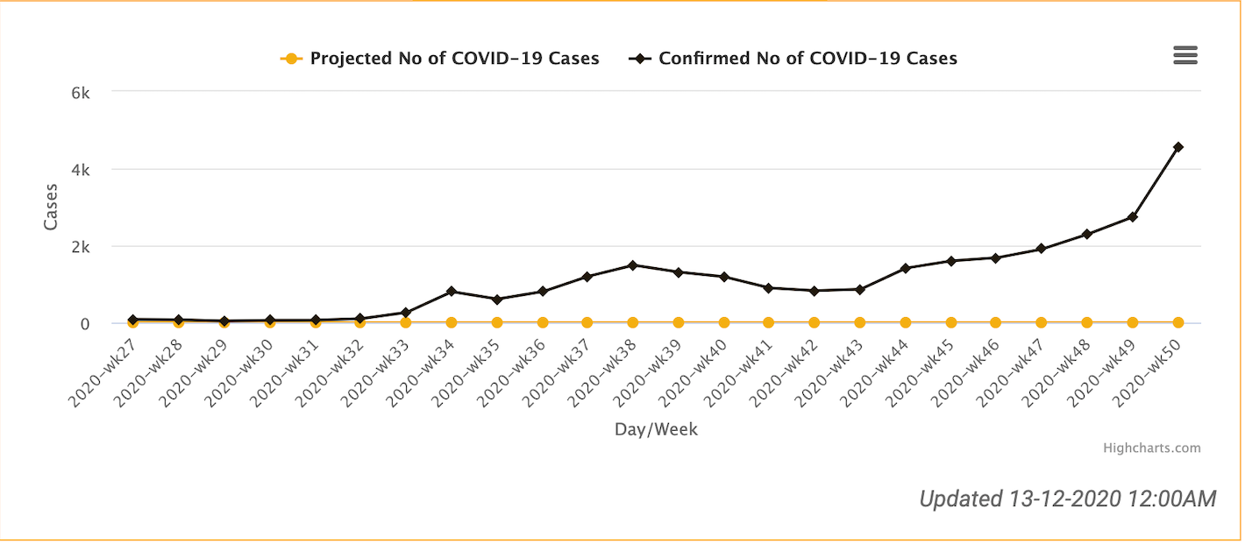
COVID-19 in Uganda.
First COVID19 case identified March 21, 2020
Early COVID19 cases imported through cross-border drivers
June 2020 – Community transmission and 1st death
Case fatality rate 2.8%
Fairly high recovery rate 63.4%
14.2 tests per 1000

Slide 3

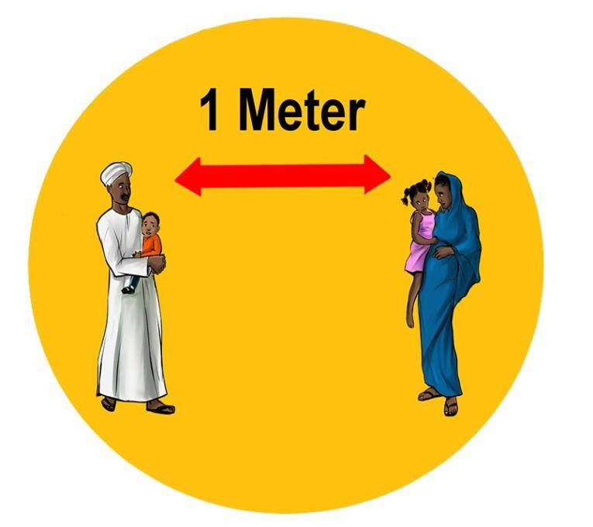

Non-pharmaceutical mitigation measures
Face masking spearheaded by government
Physical distancing key for epidemic control
Establishing community’s sentiments towards COVID-19 is key
Several online surveys conducted
Limited use of social media platforms – in Africa

Slide 4
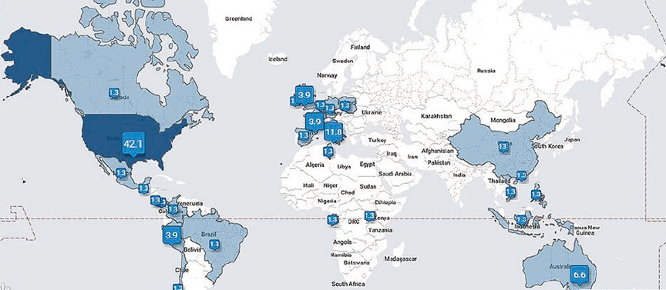
Why Twitter?
A social networking micro-blogging platform
320M active users & about 6M daily tweets
Instant dispatch of news & comments
Wealth of information and easy to access
Twitter can be used to
Predict events
Investigate processes
Monitor events, health & effect hygiene control measures

Slide 5
Research questions
What information on COVID-19 is shared via Twitter in Uganda?
What sentiments do Ugandans have towards COVID-19?
How do these sentiments relate with COVID-19 statistics?
Who are the top influencers on COVID-19 via Twitter?
Can we identify COVID-19 myths in Uganda using Twitter data?

Slide 6
Methods.
Obtained Twitter data 1st March, 2020 – 30th October, 2020
Extracted geotagged information to return tweets from Uganda
Keywords or hashtags included:
#COVID19UG, #COVID-UG, #COVID19_UG
Generated three time period: Before, During and After lockdown
Sentiment analysis – context based text evaluation for human emotions.
Sentence similarity (5-word gram) tweets with similarity to identify WHO myths on COVID-19
Analysis performed using R and Python - compares words/context (NLtoolKit)
World Health Organization COVID-19 myths busters (https://www.who.int/emergencies/diseases/novel-coronavirus-2019/advice-for-public/myth-busters)

Slide 7
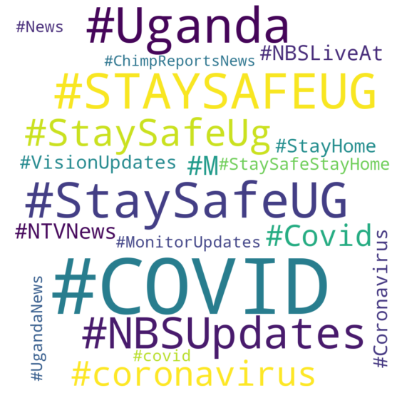
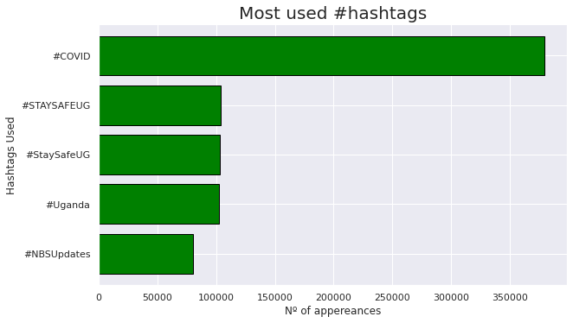
Count of Top 5 used Hashtags

Slide 8
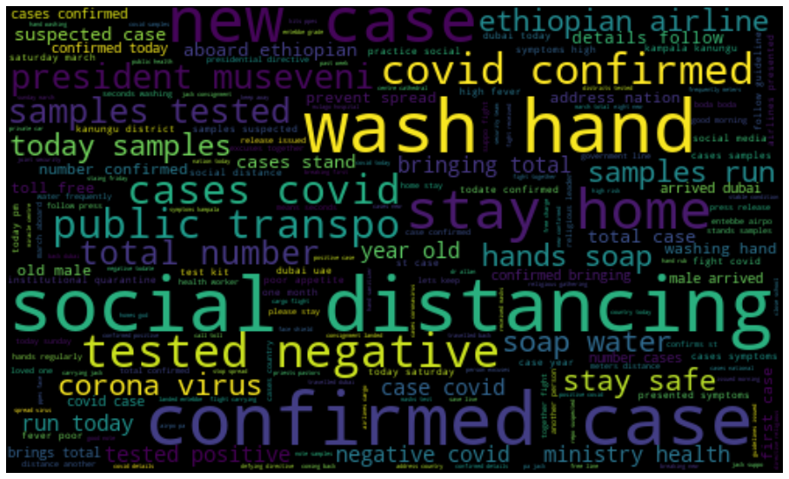
Word Cloud Before Lockdown

Slide 9
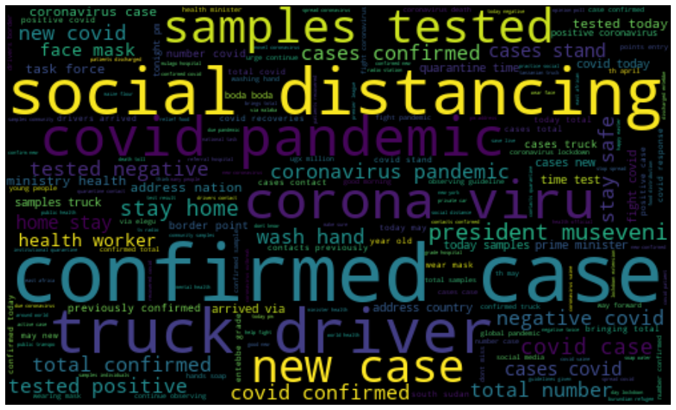
Word Cloud During Lockdown

Slide 10
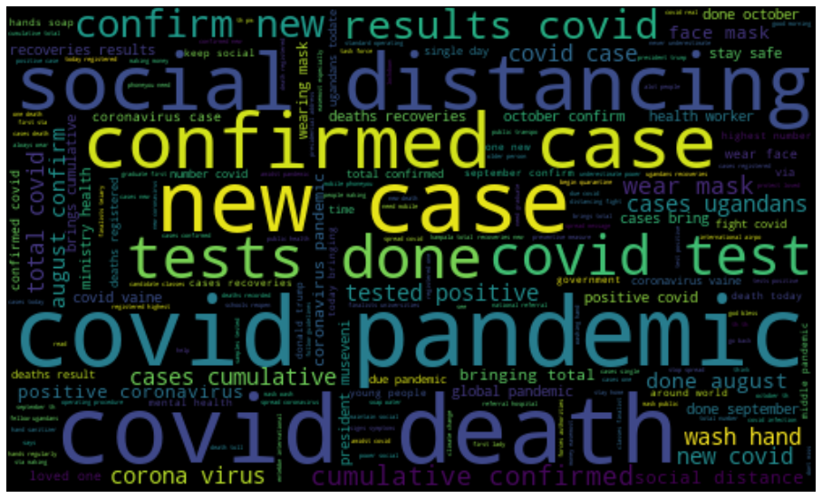
Word Cloud After Lockdown.

Slide 11
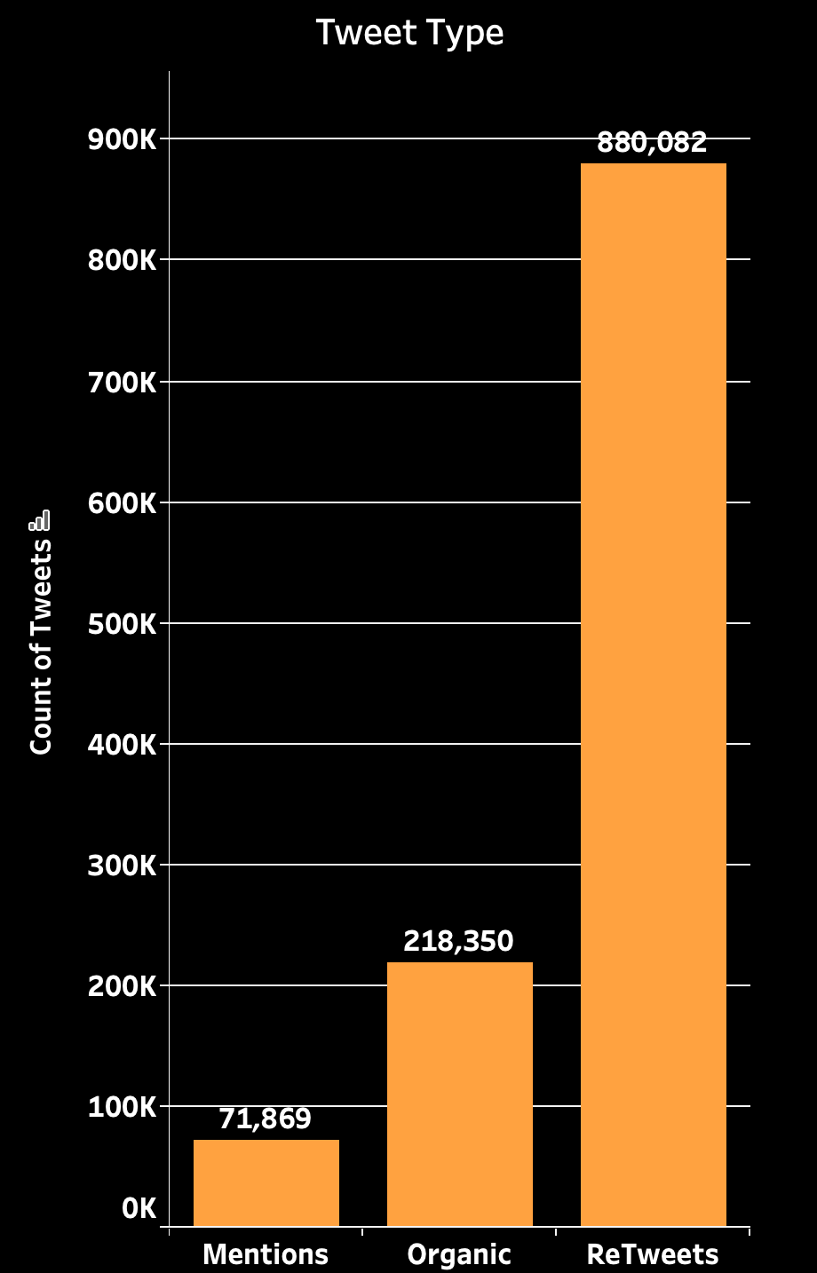
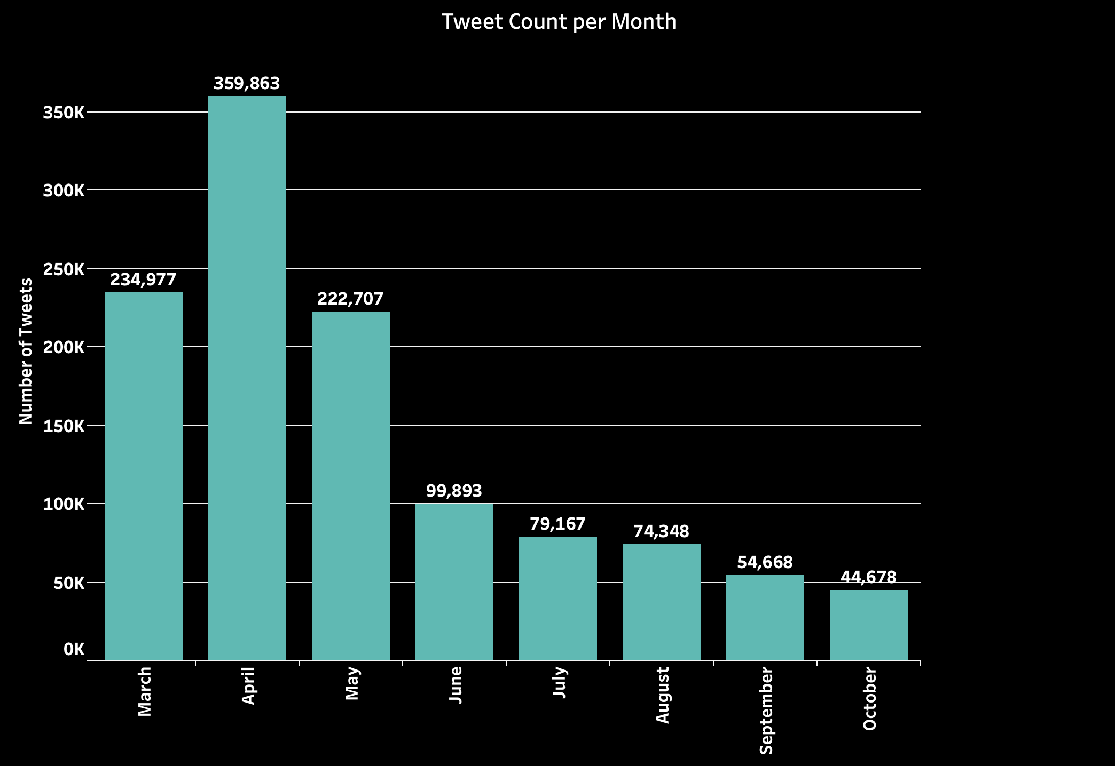
Twitter Statistics.

Slide 12
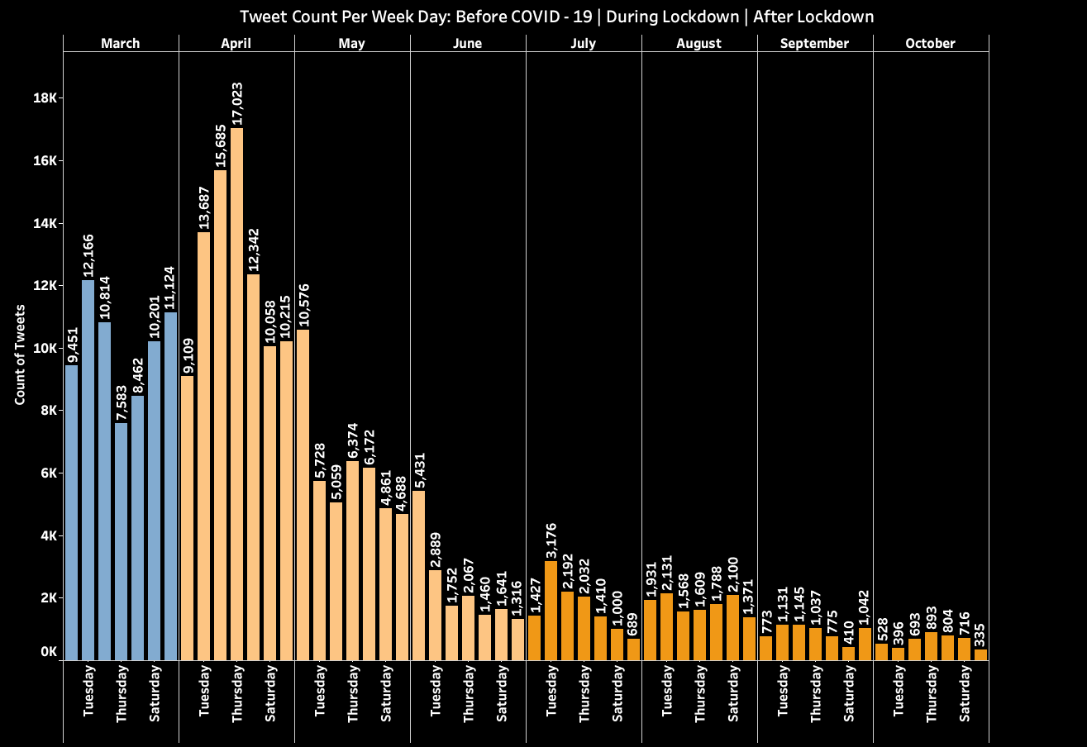

Slide 13
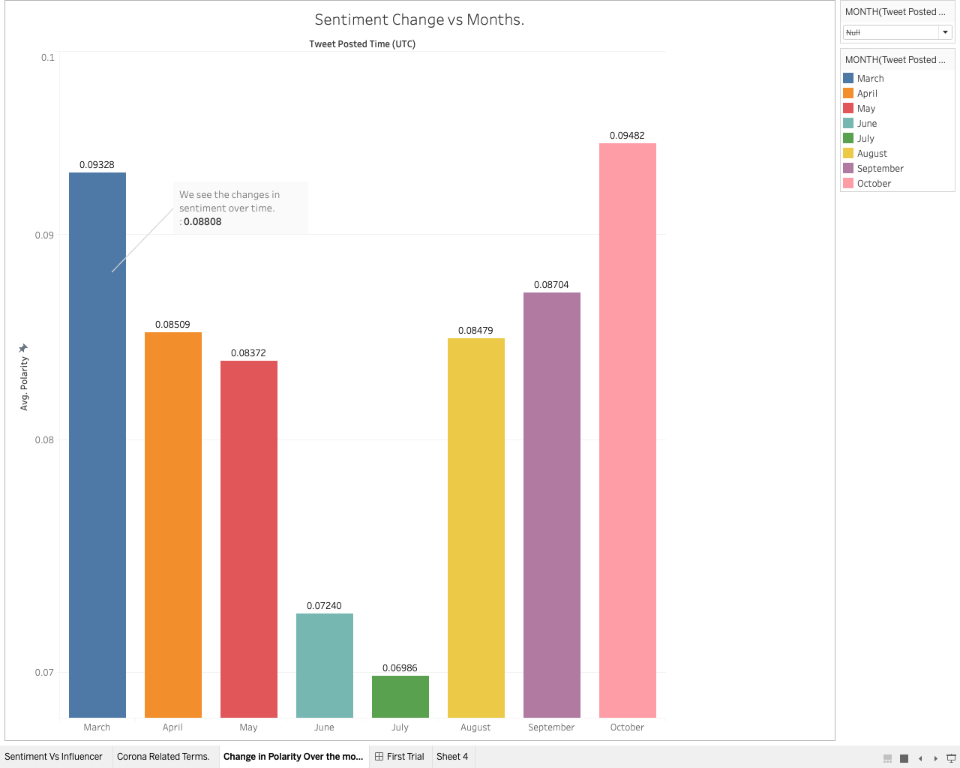

Slide 14

Who are the influencers?

Slide 15
Selection Criteria for influencers
Account age: how long the account has been active > 5yrs
Follow Ratio: the ratio of following/followers - 0.3
Engagement Ratio: Relates total number of tweets versus public engagement – higher ratio = more engagement - 1.5

Slide 16
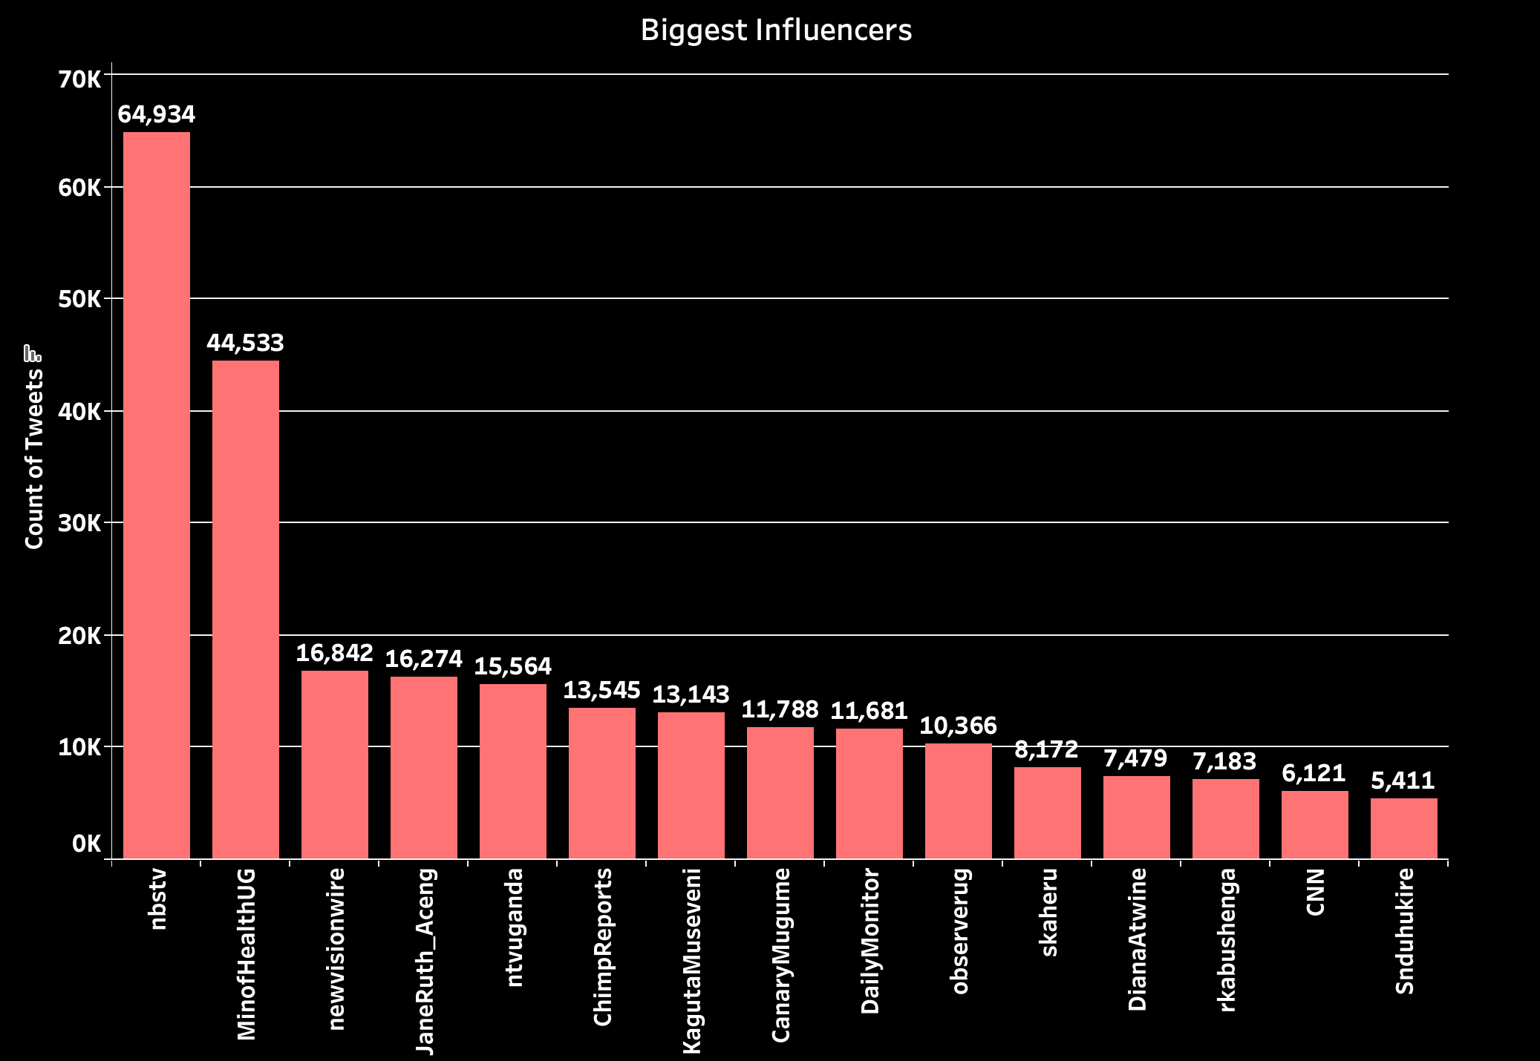

Slide 17
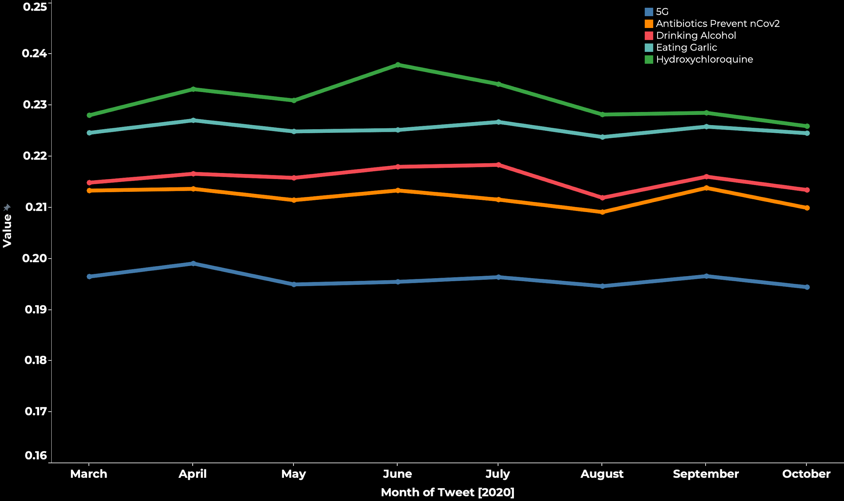

Slide 18
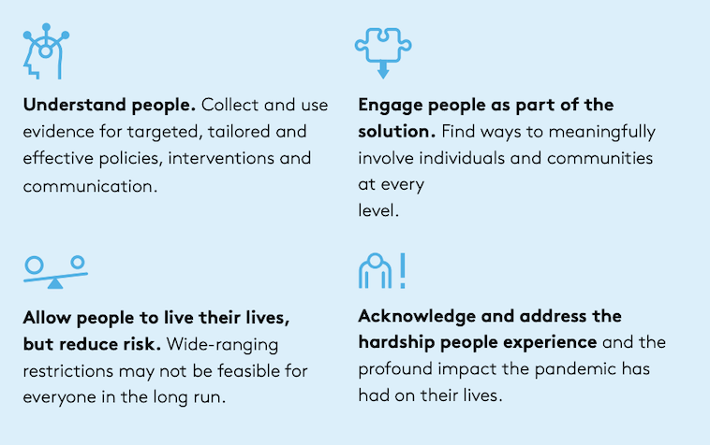
WHO Strategies for maintaining public support for COVID protective behaviours
Can we use Twitter to:
Understand sentiments towards the measures
Engage Twitter influencers in COVID-19 prevention campaigns
Document sentiments towards COVID-19 mitigation measures
Sentiment analysis to understand non-COVID-19 related hardships

Slide 19
Summary.
Data mining of Twitter data has great potential to inform response towards COVID-19
Understanding Community’s sentiments can inform selection of most useful prevention measures
Influencers via Twitter can be used as community champions for COVID-19 prevention measures
Limitations.
Selection bias – tweeters do not reflect entire population
Tweets without location – excluded and might lead to selection bias
Tweets in local languages excluded
Under-representation on COVID-19 myths – censored by Twitter

Slide 20
Next Steps
Social media analysis for other platforms and languages
Identify steps to address large scale “infodemic” surrounding COVID-19, vaccine etc in Uganda
Dashboards the detect misinformation in different regions – to inform targeted response
Analysis sentiments about other emerging topics e.g. elections and their effect on COVID-19 response

Slide 21



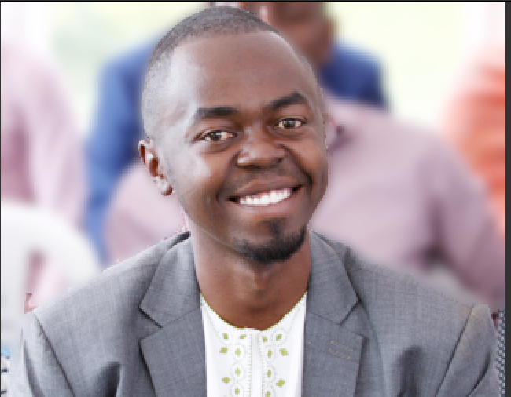
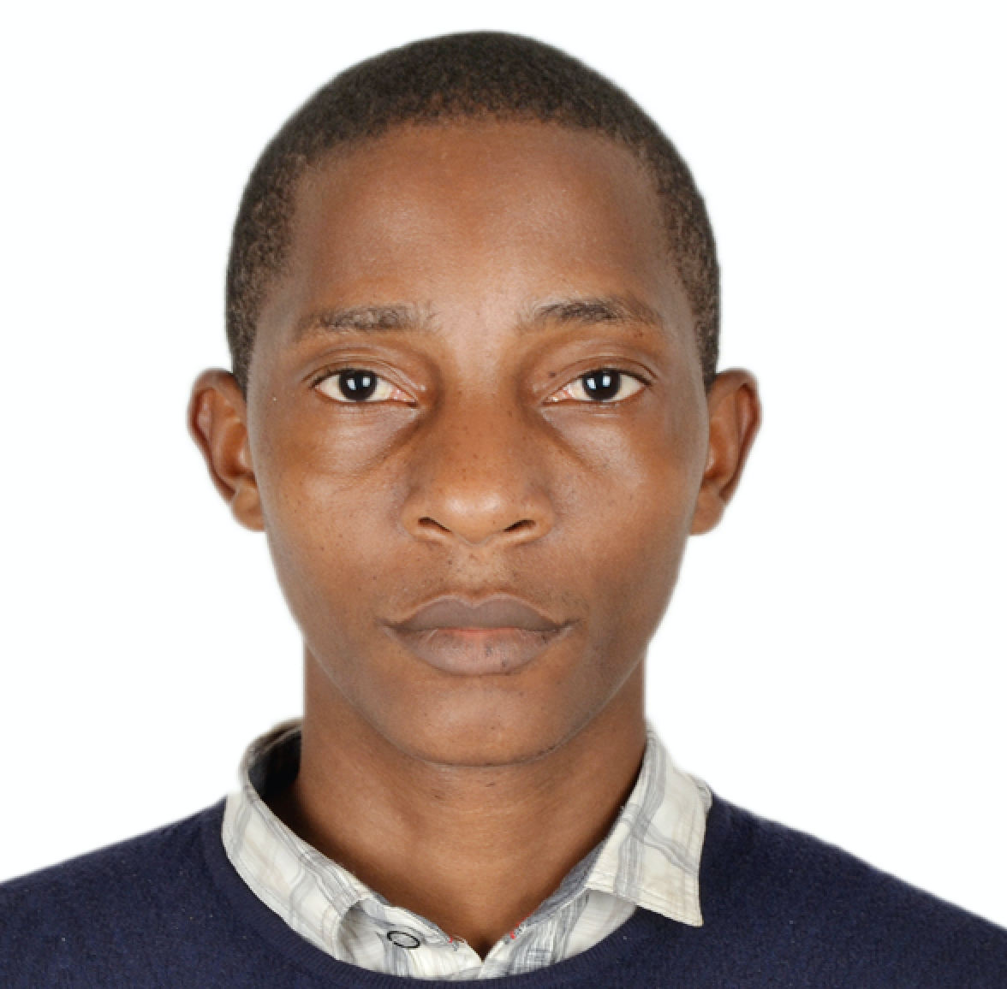


Acknowledgements
IDI data scientists
Dr. Daudi Jjingo
Dr. Gerald Mbowa
Dr. Andrew Kambugu
IDI staff – research office
Mugume Atwine
@AtwineMugume
Richard Sserunjogi
@sserurichx
Tumwa Musimbi
@c_theDiff3r3nc3

Slide 22
THANK YOU
Notes:
‹#›

